Slide 1
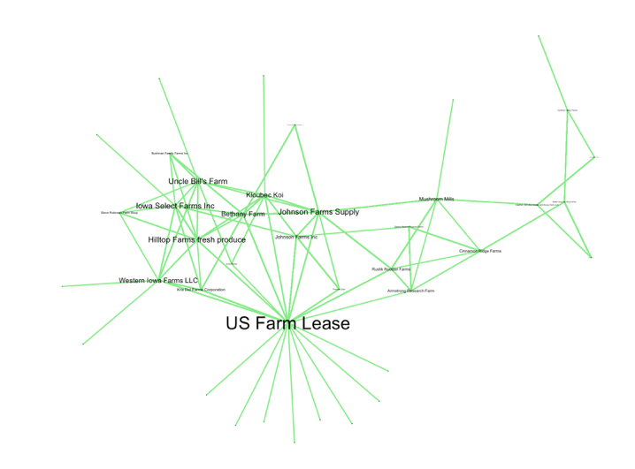
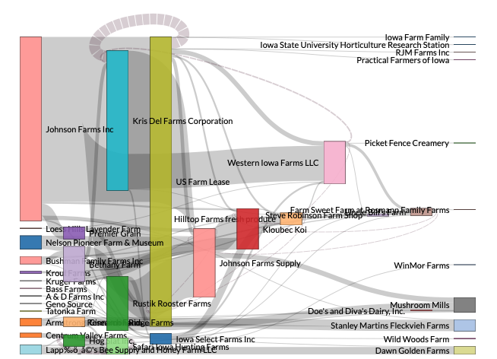
Recap Day 1
Network visualization
Network statistics

Slide 2
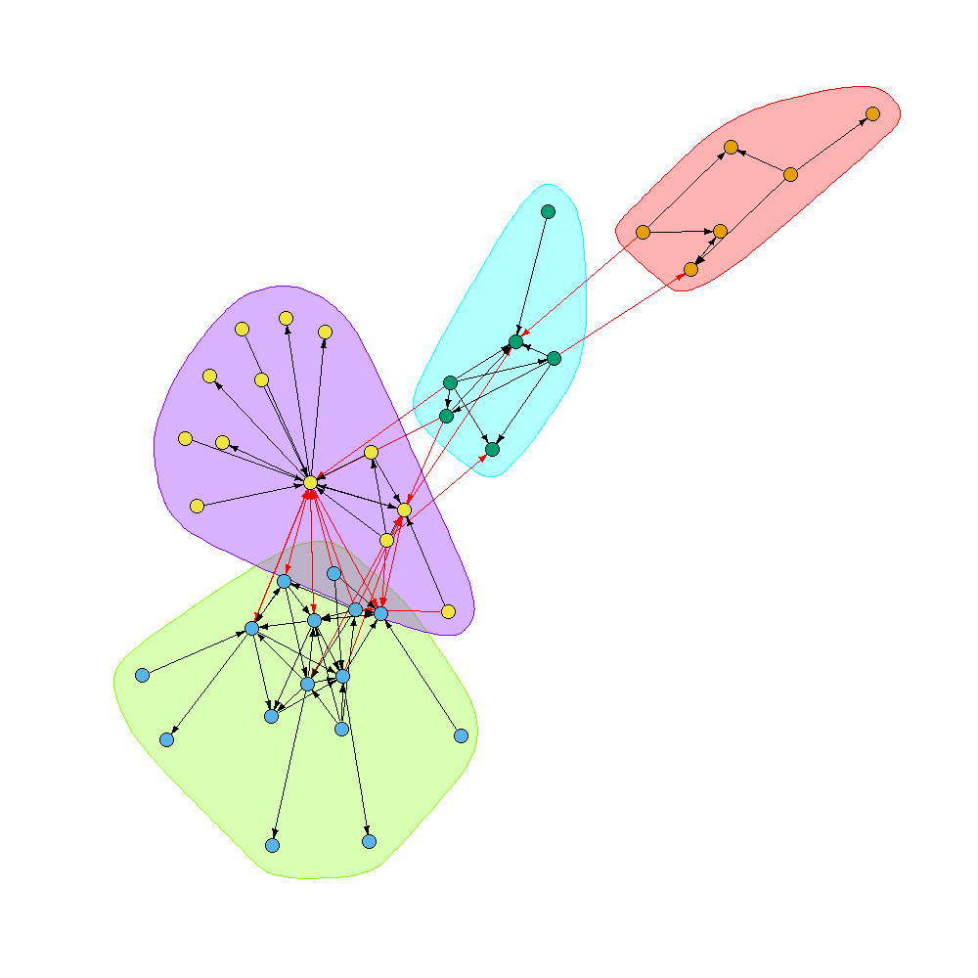
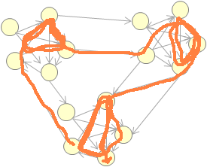
Community detection
Communities: Many intra-community contacts and few inter-community contacts
Strong Component
A subset of the network in which each pair of nodes i and j can be reached by all the others
There are many algorithms to detect communities, walktrap being one of the most popular.
I generates random paths between nodes to detect zones where it circulates more frequently within a group of nodes.
Notes:
Aplicacion practica: si una enfermedad es introducida en un nodo del strong component, es mas probable que se disemine entre la población.

Slide 3
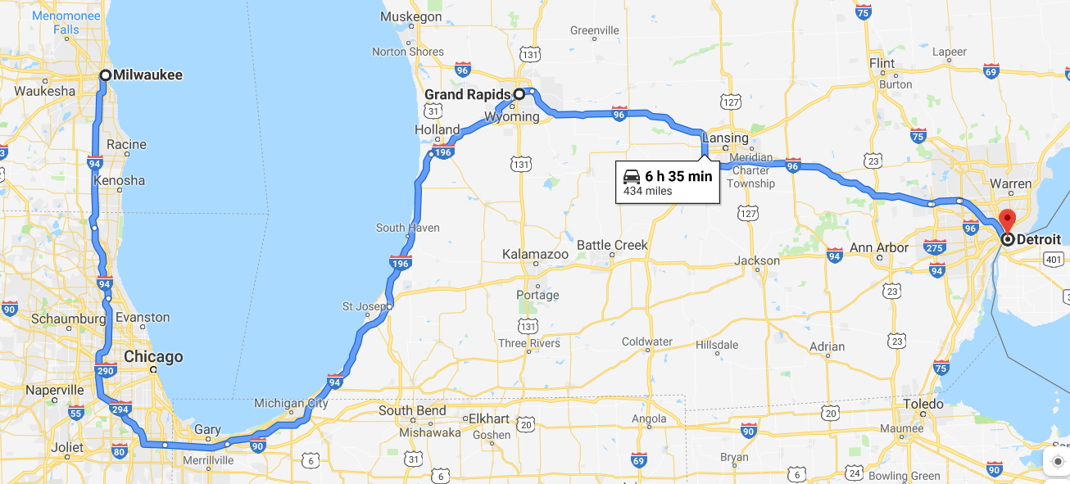
Spatial characteristics
Distance of movements
Euclidean distance
Spatial clustering
Of nodes
Of node attributes
Of edge extremities
Of traffic
Communities

Slide 4
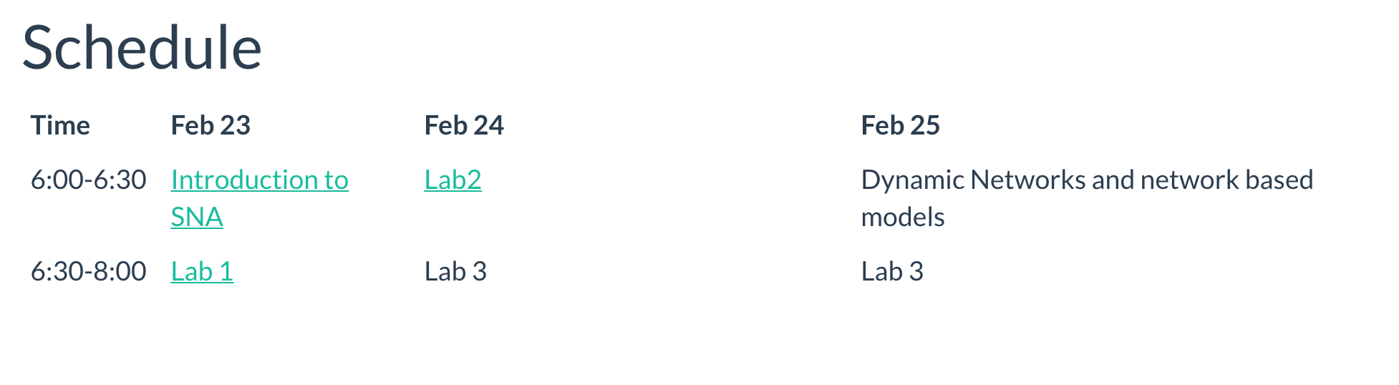
Today’s schedule

Slide 5
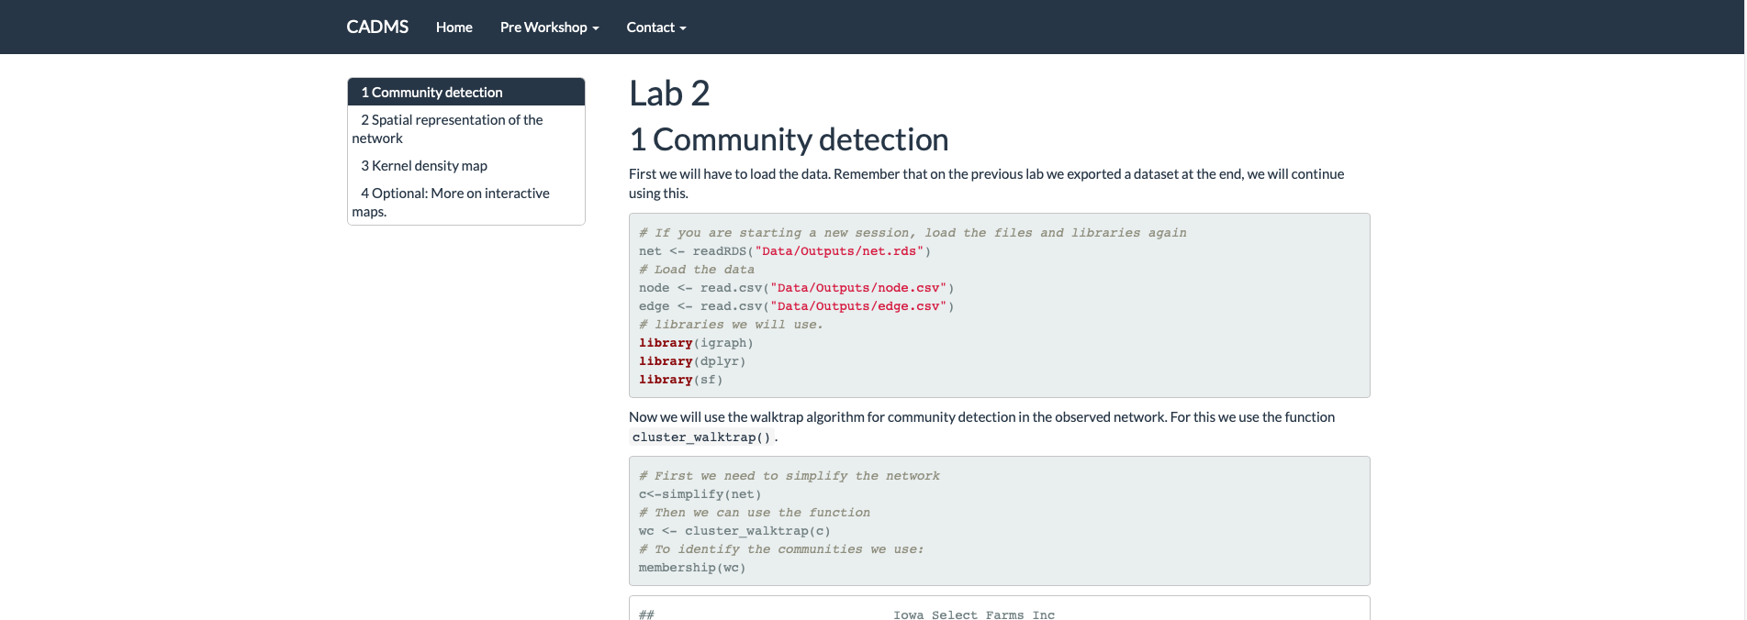
Time for lab 2

Slide 6
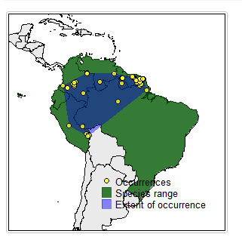
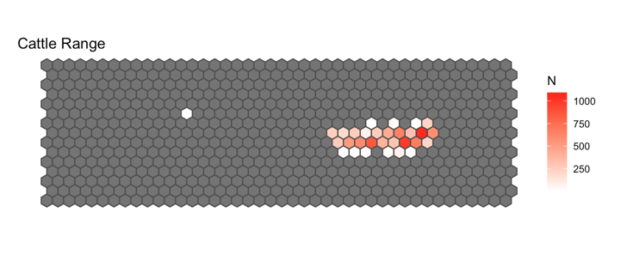
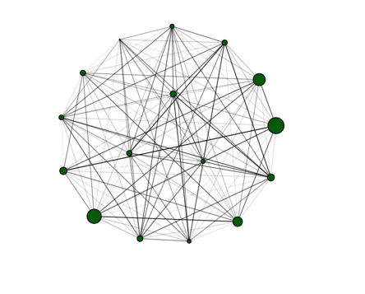
Lab 3

